Slide 1
MPI-1
Lecture 3
January 15, 2024

Slide 2
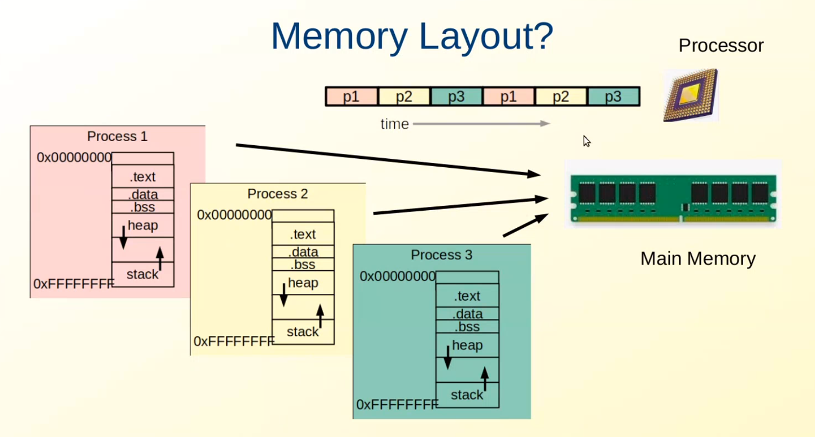
Adapted from Neha Karanjkar’s slides

Slide 3
Parallel Execution – Single Node
Core
Process
Memory
$ ps
parallel.x
parallel.x
parallel.x
parallel.x
Instruction 1
Instruction 2
…
Instruction 1
Instruction 2
…
Instruction 1
Instruction 2
…
Instruction 1
Instruction 2
…
parallel.x
parallel.x
parallel.x
parallel.x
mpirun -np 4 ./parallel.x

Slide 4
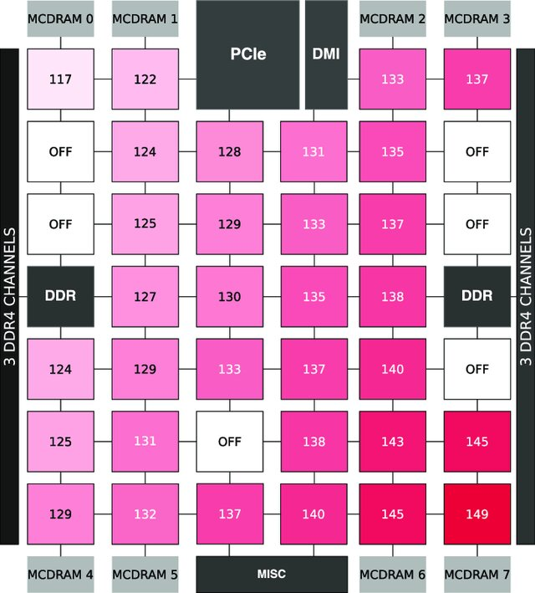
Access Latency (Intel KNL)
Simulating the Network Activity of Modern Manycores, IEEE Access 2019

Slide 5
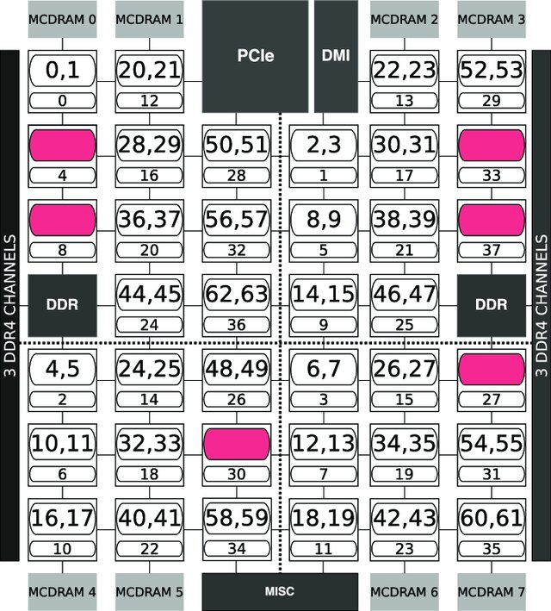
Cores
Simulating the Network Activity of Modern Manycores, IEEE Access 2019

Slide 6
Parallel Execution – Multiple Nodes
Core
Process
Memory
Instruction 1
Instruction 2
…
Instruction 1
Instruction 2
…
Instruction 1
Instruction 2
…
Instruction 1
Instruction 2
…
parallel.x
parallel.x
parallel.x
parallel.x
SIMD
parallel.x
parallel.x
parallel.x
parallel.x
mpirun -np 8 ./parallel.x

Slide 7
MPI Code On Multiple Nodes
mpirun -np 8 –f hostfile ./program.x
Round robin process placement
  mpirun -np 8 –hosts h1,h2,h3,h4 ./program.x
Host-wise placement
  mpirun -np 8 –hosts h1:2,h2:2,h3:2,h4:2 ./program.x

Slide 8
Parallel Execution – Multiple Nodes
Core
Process
Memory
Instruction 1
Instruction 2
…
Instruction 1
Instruction 2
…
Instruction 1
Instruction 2
…
Instruction 1
Instruction 2
…
parallel.x
parallel.x
parallel.x
parallel.x
parallel.x
parallel.x
parallel.x
parallel.x
  mpirun -np 8 -hosts h1,h2,h3,h4 ./program.x
  mpirun -np 8 -hosts h1:2,h2:2,h3:2,h4:2 ./program.x

Slide 9
Parallel Sum (Optimized)
Source: GGKK Chapter 5

Slide 10
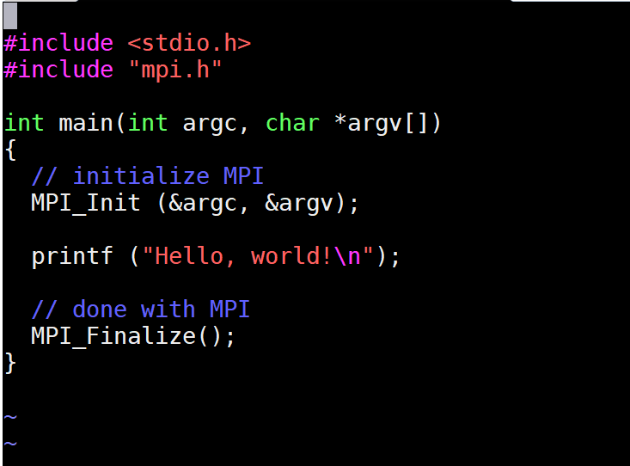
Getting Started
gather information about the parallel job
set up internal library state
prepare for communication
Initialization
Finalization

Slide 11
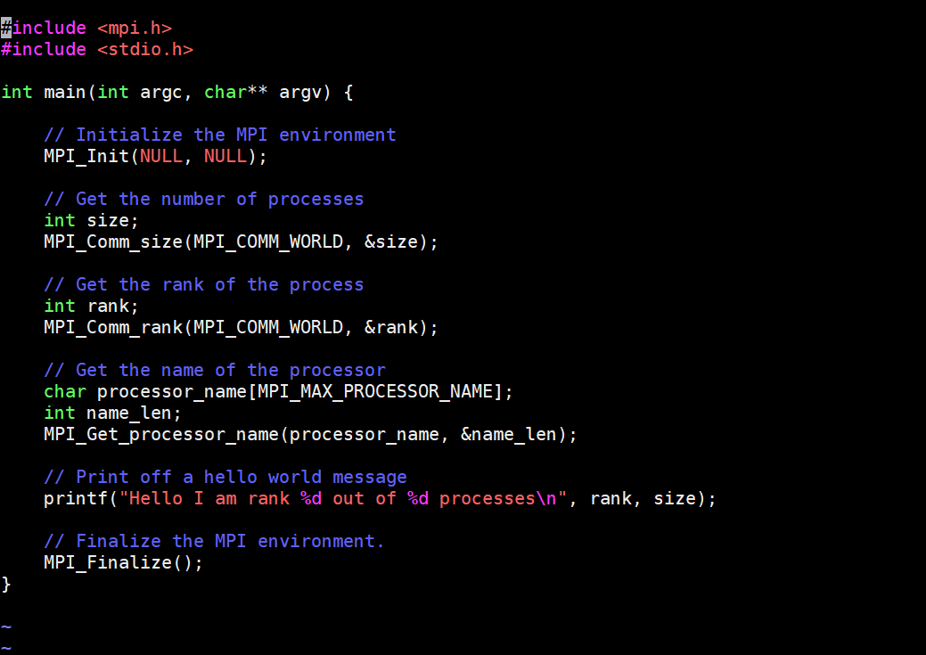
MPI Process Identification
Global communicator
Total number of processes
Rank of a process

Slide 12
Entities
Communicator (communication handle)
Defines the scope
Specifies communication context
Process
Belongs to a group
Identified by a rank within a group
Identification
MPI_Comm_size – total number of processes in communicator
MPI_Comm_rank – rank in the communicator

Slide 13
MPI_COMM_WORLD
Required in every MPI communication
Process identified by rank/id
3
2
0
4
1

Slide 14
Communicator
Communication handle among a group/collection of processes
Representative of communication domain
Associated with a context ID (in MPICH)
Predefined:
  MPI_COMM_WORLD
  MPI_COMM_SELF

Slide 15
Output
// get number of tasks
MPI_Comm_size (MPI_COMM_WORLD, &numtasks);
// get my rank
MPI_Comm_rank (MPI_COMM_WORLD, &rank);
printf (“Hello I’m rank %d of %d processes\n”, rank, numtasks);
mpiexec –n 4 –hosts host1,host2,host3,host4 ./exe
mpiexec –n 4 –hosts host1:2,host2:2,host3:2,host4:2 ./exe
mpiexec –n 8 –hosts host1,host2,host3,host4 ./exe
mpiexec –n 8 –hosts host1:1,host2:2,host3:3,host4:4 ./exe

Slide 16
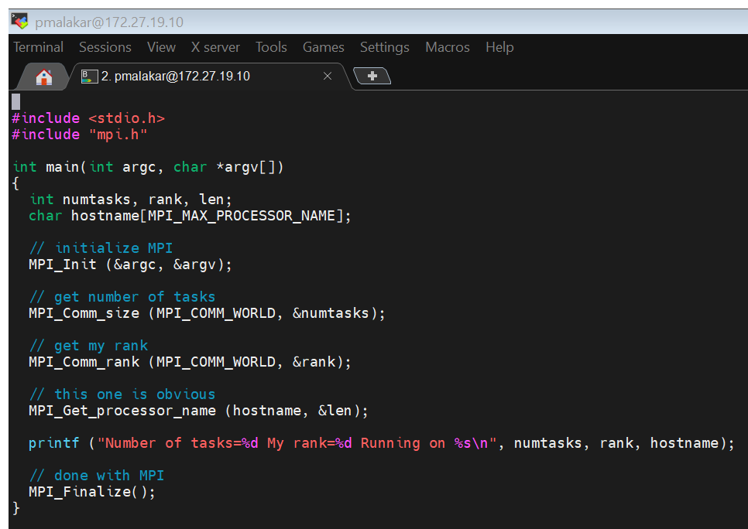
Host

Slide 17
Process Launch
Memory
MPI process
MPI process
MPI process
MPI process
Launch node
Reading (optional):
A Scalable Process-Management Environment for Parallel Programs
Notes:
Multipurpose daemons used to be connected via ring They need to know who sent msg, how to communicate
Mpdboot Mpd.hosts
\item[MPD-2] is a process management system that consists of a ring of daemons, one on each node. It also supports the ``simple'' client side PMI implementation. It supplies multiple services for the parallel processes, including scalable startup and stdio management. The ring can be either permanent, run by root, or can be deployed separately for each job. The MPD daemons fork a ring of ``manager'' processes for a single job, and these managers set up the PMI socket before forking the application processes. The managers hold the KVS's in a distributed way, so that {\tt put} operations are local but {\tt get} requests may have to circulate in the manager ring. The {\tt barrier} operation is implemented by circulating a token around the manager ring. Other topologies (e.g. ring of rings) for the MPD's and managers are possible, but have not yet been implemented.

Slide 18
Parallel Environment
Job scheduler
  Resources to run the parallel job
Process manager
  Starts and stops the processes
Parallel library
  Application calls for communication

Slide 19
Multiprocess Daemon
Butler et al., EuroPVM/MPI2000

Slide 20
Process Management Setup
Parallel program library (e.g. MPI)
Process management interface (PMI)
Resource manager/ Job scheduler/ Process Manager
Reading (optional):
PMI: A Scalable Parallel Process-Management Interface for Extreme-Scale Systems
Notes:
exchange of any information required to contact other processes in the same parallel job, takes place through the process management interface or PMI.
There are four separate sets of functionalities:
Creating, connecting with, and exiting parallel jobs
Accessing information about the parallel job or the node on which a process is running
Exchanging information used to connect processes together
Exchanging information related to the MPI Name publishing interface
Process managers are basically external (typically distributed) agents that spawn and manage parallel jobs. These process managers communicate with MPICH processes using a predefined interface called as PMI (process management interface). Since the interface is (informally) standardized within MPICH and its derivatives, you can use any process manager from MPICH or its derivatives with any MPI application built with MPICH or any of its derivatives, as long as they follow the same wire protocol. There are three known implementations of the PMI wire protocol: "simple", "smpd" and "slurm".

Slide 21
Process Manager
Start and stop processes in a scalable way
Setup communication channels for parallel processes
stdin/stdout/stderr forwarding
  ./a.out 2>efile
Notes:
Redirection is a Linux feature. With the help of it, you are able to change standard I/O devices. In Linux, when you enter a command as an input, you receive an output. It’s the basic workflow of Linux.
Process managers are basically external (typically distributed) agents that spawn and manage parallel jobs. These process managers communicate with MPICH processes using a predefined interface called as PMI (process management interface). Since the interface is (informally) standardized within MPICH and its derivatives, you can use any process manager from MPICH or its derivatives with any MPI application built with MPICH or any of its derivatives, as long as they follow the same wire protocol. There are three known implementations of the PMI wire protocol: "simple", "smpd" and "slurm". By default, MPICH and all its derivatives use the "simple" PMI wire protocol, but MPICH can be configured to use "smpd" or "slurm" as well.

Slide 22
Process Management Interface
Interface between process manager and MPI library
Processes can exchange information about peers by querying PMI
Uses key-value store for process-related data
Notes:
Process managers are basically external (typically distributed) agents that spawn and manage parallel jobs. These process managers communicate with MPICH processes using a predefined interface called as PMI (process management interface). Since the interface is (informally) standardized within MPICH and its derivatives, you can use any process manager from MPICH or its derivatives with any MPI application built with MPICH or any of its derivatives, as long as they follow the same wire protocol. There are three known implementations of the PMI wire protocol: "simple", "smpd" and "slurm". By default, MPICH and all its derivatives use the "simple" PMI wire protocol, but MPICH can be configured to use "smpd" or "slurm" as well.

Slide 23
Process Launch
Memory
MPI process
MPI process
MPI process
MPI process
PMI
PMI
PMI
PMI
Notes:
conveying the communication-establishment information.
The client establishes a connection to the server. The client may choose to, and/or the server may require that the client, use a secure connection, such as OpenSSL. This part of the wire protocol is not defined. It is recommended that clients and servers either use OpenSSL or use plain sockets, making use of the authentication extensions defined below on the fullinit command.
In order to initialize the connection between the client and the server, the client needs to know how to establish the connection. These may be specified by the following environment variables:
The MPI process can either request for a signal during the initialization (in which case the PMI server has to send the message and follow it up with a signal) or request for no signal (in which case the MPI process has to continuously monitor this socket using either a SIGIO or a separate thread blocking on the socket).

Slide 24
Process Launch
Memory
PMI
PMI
PMI
PMI
KVS $
KVS $
KVS $
KVS $
Notes:
Commands are exchanged between the PMI client and server in a simple, key-value format.

Slide 25
Hydra Process Manager
A process management system for starting parallel jobs
Uses existing daemons (viz. ssh) to start MPI processes
Automatically detects resource managers if any and interacts with them
$ mpiexec ./app
  Hydra gets information about allocated resources and launches processes
Passes environment variables from the shell on which mpiexec is launched to the launched processes
There are others – gforker, slurm, etc.
Notes:
https://wiki.mpich.org/mpich/index.php/Hydra_Process_Management_Framework

Slide 26
mpiexec
Memory
host1
host2
host3
host4
Launch node
Proxy
Proxy
Proxy
Proxy
mpiexec –n 4 –hosts host1,host2,host3,host4 ./exe
Notes:
Coming to our view
Implementation Notes: PMI_Init is called within MPI_Init or MPI_Init_thread, and should not make calls to MPI functions.
One exception is for the MPI error class and code functions. PMI_Init may use MPI_Add_error_class and MPI_Add_error_code
.

Slide 27
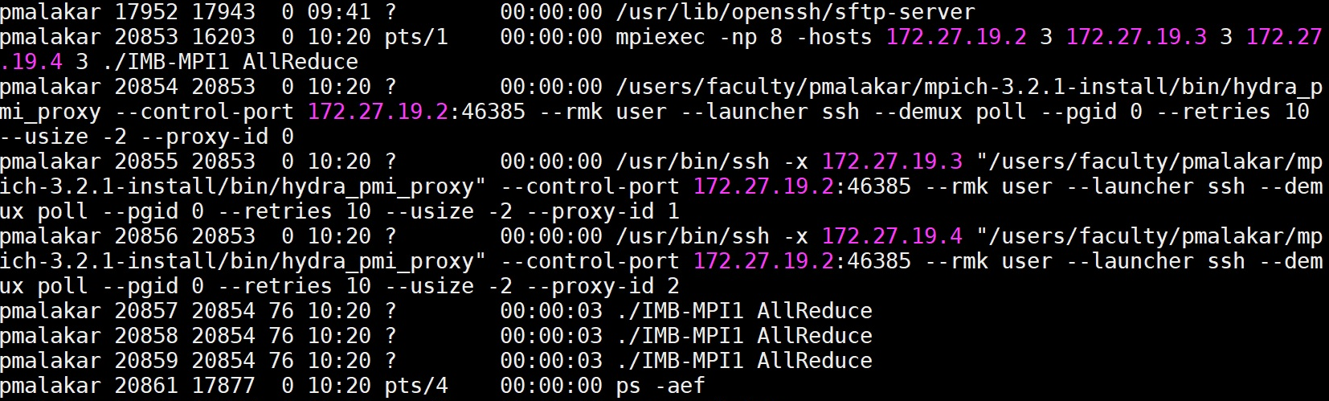
Launch Node
mpiexec -np 8 -hosts host1:3,host2:3,host3:3 ./exe
Notes:
Proxy id 0 1 2

Slide 28
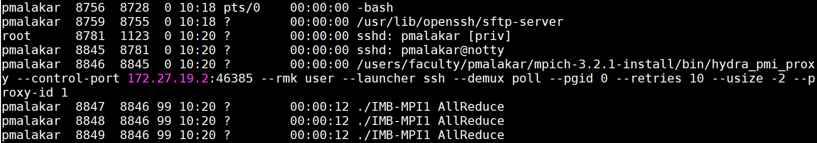
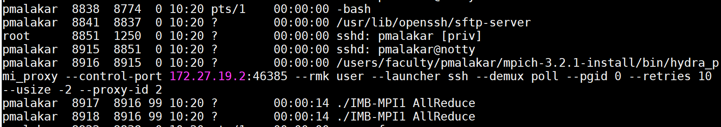
Compute Node Processes

Slide 29
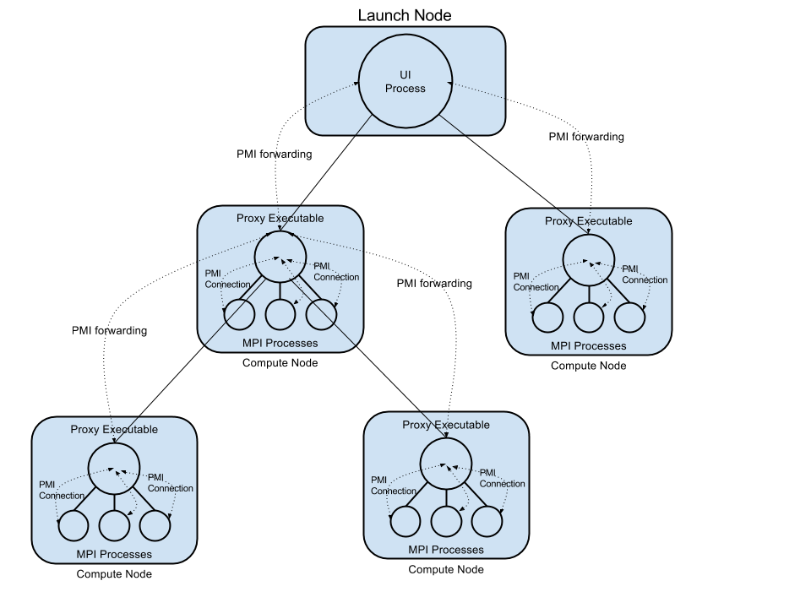
Hydra and mpiexec
Source: wiki.mpich.org

Slide 30
MPI Process Management
Initializes and queries PMI

Slide 31
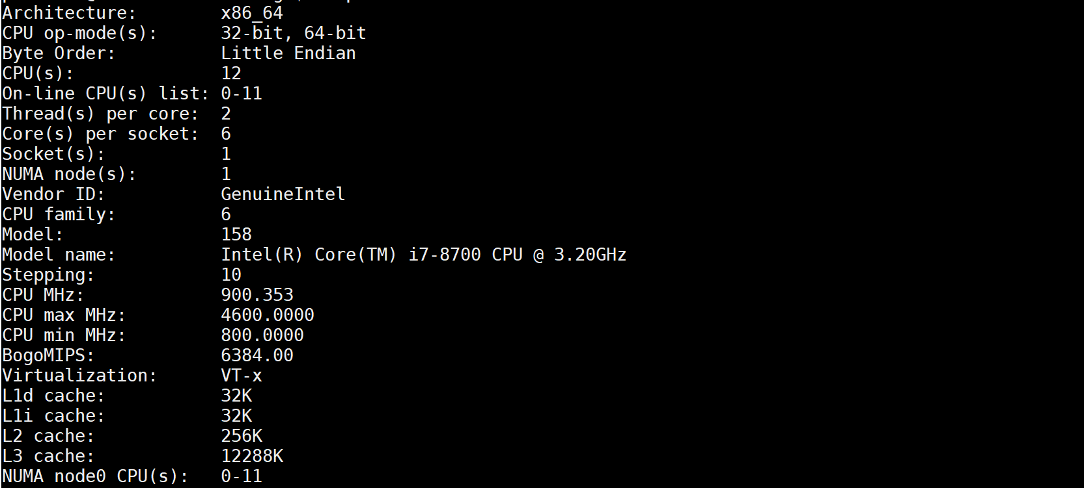

csews*
lscpu

Slide 32
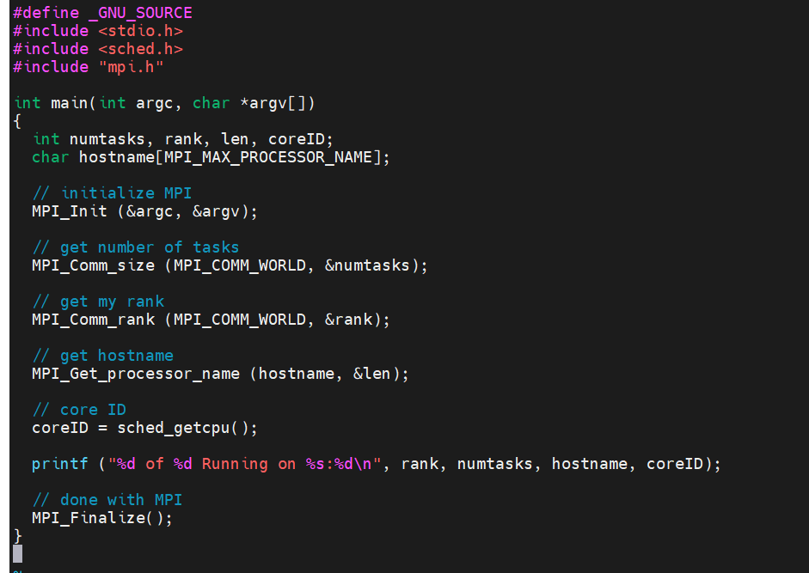
Multiple Tasks Core ID
Get the core ID

Slide 33
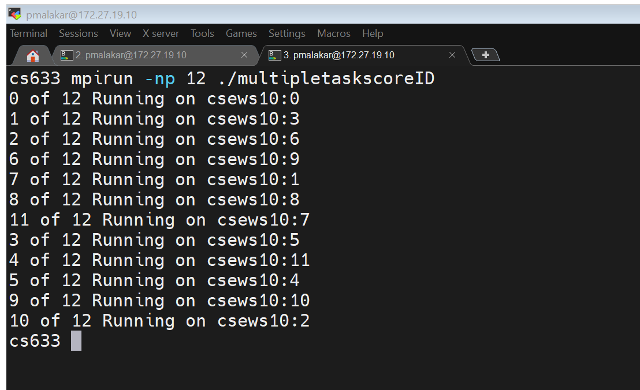
Process Placement

Slide 34
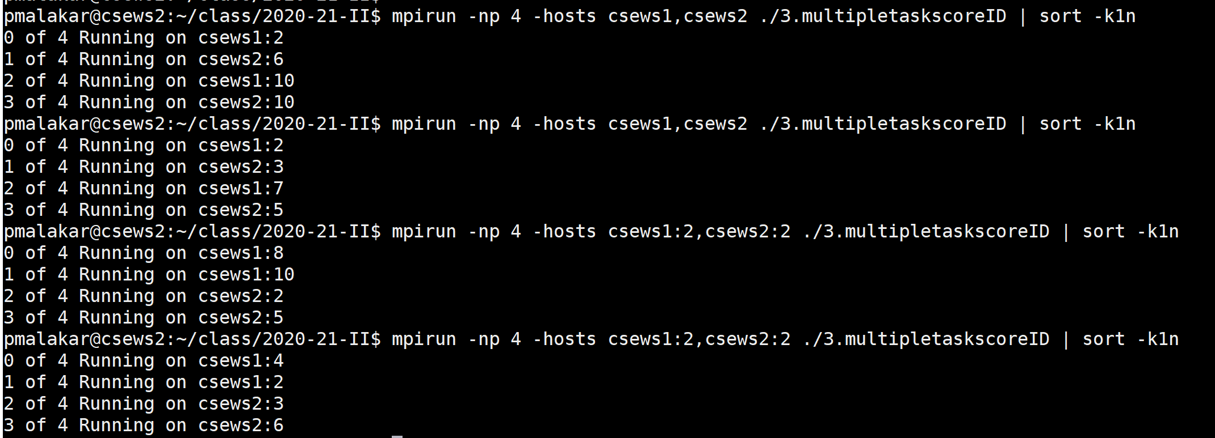
Process Placement

Slide 35
Executing MPI programs
Check `which mpicc` and `which mpiexec`
  Update PATH environment variable
Compile
  mpicc –o filename filename.c
Run
  mpiexec –np 4 –f hostfile filename [Often “No such file” error]
  mpiexec –np 4 –f hostfile ./filename

Slide 36
Resources for MPI
Marc Snir, Steve W. Otto, Steven Huss-Lederman, David W. Walker and Jack Dongarra,
MPI - The Complete Reference, Second Edition, Volume 1, The MPI Core.
William Gropp, Ewing Lusk, Anthony Skjellum,
Using MPI: portable parallel programming with the message-passing interface, 3rd Ed., Cambridge MIT Press, 2014.
https://www.mpi-forum.org/docs/mpi-4.0/mpi40-report.pdf

Slide 37
Message Passing Paradigm
Message sends and receives
Explicit communication
Communication patterns
Point-to-point
Collective

Slide 38
Communication – Message Passing
Process 0
Process 1

Slide 39
Message Passing
Process 0
Process 1
Process 2
Process 3

Slide 40
MPI Basics
Process is identified by rank
Communicator specifies communication context
Message Envelope
Source
Destination
Communicator
Tag (0:MPI_TAG_UB)

Slide 41
MPI Data Types
MPI_BYTE
MPI_CHAR
MPI_INT
MPI_FLOAT
MPI_DOUBLE

Slide 42
Point-to-point Communication
Blocking send and receive
MPI_Send
MPI_Recv
int MPI_Send (const void *buf, int count, MPI_Datatype datatype, int dest, int tag, MPI_Comm comm)
SENDER
Tags should match
int MPI_Recv (void *buf, int count, MPI_Datatype datatype, int source, int tag, MPI_Comm comm, MPI_Status *status)
RECEIVER

Slide 43
Code
http://web.cse.iitk.ac.in/users/pmalakar/cs633/2022-23/code/1.Jan13.tar.gz

Slide 44
CSE Lab Cluster
~ 80 nodes connected via Ethernet
Each node has 12/8/4 cores
Intel(R) Core(TM) i7-8700 CPU @ 3.20GHz
NFS filesystem
  Your home directories are NFS-mounted on all nodes
Login with CSE login credentials to any machine (IP address range 172.27.19.1 – 172.27.19.80)
  It’s possible that some machines are not reachable/usable, try some other IP
Notes:
Floors connected tree switch cse logins non-cse send email

Slide 45
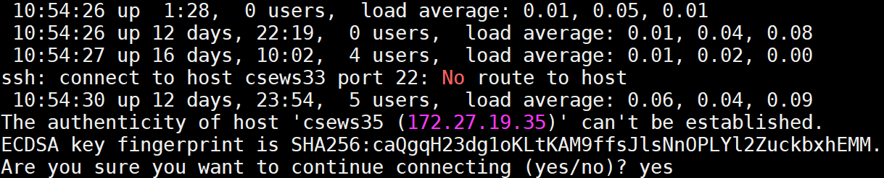
CSE Lab Cluster
Enable passwordless ssh (ssh-keygen)
ssh csewsX (from any csews*) passwordlessly
for i in `seq 1 80`; do ssh csews$i uptime ; done
“Are you sure you want to continue connecting?” yes

Slide 46
MPI Installation – Cluster
Install MPICH 4.0.3 (https://www.mpich.org/static/downloads/4.0.3/) in your home directory (from any node)
Download mpich-4.0.3.tar.gz
Follow installation instructions from
https://www.mpich.org/static/downloads/4.0.3/mpich-4.0.3-installguide.pdf
DO NOT use /tmp
If mpirun is already installed locally on the system, do not use that node to install (which mpirun)
Verify after installation that `which mpirun` from any node points to your installation

Slide 47
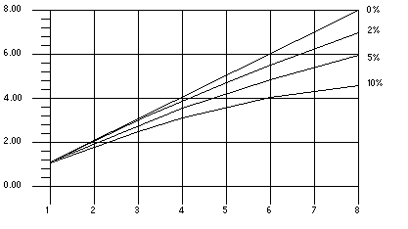
Speedup (Amdahl’s Law)

Slide 48
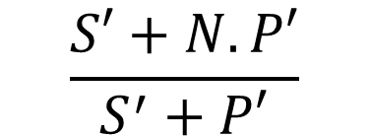
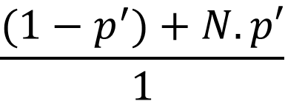
Scaled Speedup: Gustafson’s Law
Speedup S’ =
$$\frac{S′+N.P′}{S^{′}+P′}$$
=
$$\frac{(1−p^{′})+N.p′}{1}$$

